Slide 1
PONTIFÍCIA UNIVERSIDADE CATÓLICA DE SÃO PAULO
CURSO DE ESPECIALIZAÇÃO EM ENGENHARIA DE SOFTWARE
Modelagem de Software
Orientado a Objetos
Modelagem de Software
Orientado a Objetos
Parte 2- Princípios de Modelagem UML
Outros Diagramas da UML
Prof. Maurício Nacib Pontuschka
tuska@pucsp.br

Slide 2
Objetivos
Modelagem de Software Orientado a Objetos
Princípios de Modelagem UML
Demonstrar como ler e interpretar um:
  Diagrama de máquina de estados
  Diagrama de componentes
  Diagrama de Implantação
Notes:
Introduce the objectives for this module.

Slide 3

Onde Estamos?
Modelagem de Software Orientado a Objetos
Princípios de Modelagem UML
Diagrama de máquina de estados
Diagrama de componentes
Diagrama de implantação
Notes:
The goal for this section is to introduce, not teach everything about state machines.

Slide 4
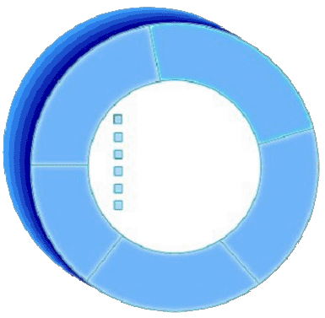
Revisão: Um objeto possui estados
Modelagem de Software Orientado a Objetos
Princípios de Modelagem UML
Estado é a condição ou situação durante a vida de um objeto, a qual satisfaz alguma condição, executa alguma atividade ou aguarda por algum evento.
O estado de um objeto normalmente muda ao longo do tempo.
Nome: J Clark
ID: 567138
Contr: 07/25/1991
Estado: Titular
Disciplina: Finanças
Carga máx.: 3
Nome: J Clark
ID: 567138
Data Contratação: July 25, 1991
Estado: Titular
Disciplina: Finanças
Carga máxima: 3 classes
Professor Clark
Notes:
The state of an object is one of the possible conditions that an object may exist in, and it normally changes over time.
The state of an object is usually implemented by a set of properties called attributes, along with the values of the properties and the links the object may have with other objects.
State is not defined by a “state” attribute or set of attributes. Instead, state is defined by the total of an object’s attributes and links. For example, if Professor Clark’s status changed from Tenured to Retired, the state of the Professor Clark object would change.
Review the definition of state. The state of an object is primarily defined through its attributes.
In the next couple of slides, show the students that we will use the values of the Status attribute as a state in a state machine. The example of becoming a professor in the next slide is meant to explain how the state of an object changes over time.

Slide 5

Exemplo: Professor
Modelagem de Software Orientado a Objetos
Princípios de Modelagem UML
Existe uma seqüência de eventos entre um instrutor se tornar um professor universitário.
  Professor assistente (será efetivo através de um número de publicações de qualidade)
  Professor Efetivo/Associado
  Titular
  (baseado na sua contribuição acadêmica)
Notes:
The example of someone becoming a college professor serves us well in explaining how a state machine works. When you are hired for a teaching position at the university, you begin as an assistant professor. Based on your successful publication of numerous quality papers, you receive tenure and the title of assistant professor. There is not an automatic time line for becoming an associate professor, it is based on producing and publishing quality papers. However after you have tenure, seniority makes you available for the next available professorship.
Before an instructor becomes a University professor, they are first an assistant and then an associate professor. Each of these states or steps must satisfy some condition.

Slide 6
O que são diagramas de máquina de estados?
Modelagem de Software Orientado a Objetos
Princípios de Modelagem UML
Um diagrama de máquina de modela o comportamento dinâmico.
Ele especifica a seqüência de estados nos quais um objeto pode existir:
  Os eventos e condições que levam o objeto a alcançar tais estados
  As ações acionadas quando tais estados são alcançados
Professor
assistente
Efetivo
Notes:
A state machine diagram is typically used to model the discrete stages of an object’s lifetime. They show the sequences of state that an object goes through, the events that cause a transition from one state to another, and the actions that result from the state change. State machine diagrams are closely related to activity diagrams.
Each state represents a named condition during the life of an object in which it satisfies some condition or waits for some event. A state machine diagram typically contains one start and multiple end states. Transitions connect the various states on the diagram. Like activity diagrams, decisions, and synchronizations may also appear on state machine diagrams.
State machines are used to model the dynamic behavior of a model element, and more specifically, the event-driven aspects of the system's behavior. State machines are specifically used to define state-dependent behavior, or behavior that varies depending on which state the model element is in. Model elements whose behavior does not vary with the state, do not require state machines to describe their behavior. These elements are typically passive classes whose primary responsibility is to manage data.
Introduce the concept of state machines.
A state machine diagram shows a state machine, emphasizing the flow of control from state to state.
Using the previous example, J. Clarke was an associate professor before she achieved tenure and became a full Professor.
Another type of state machine that has been formalized in UML 2 is the Protocol State Machine. This is used to express usage protocols by defining rules on the invocation of operations or exchange of messages that a behavioral state machine or procedure may perform. This course does not cover these diagrams.

Slide 7
Estados especiais
Modelagem de Software Orientado a Objetos
Princípios de Modelagem UML
O estado inicial é o estado que o objeto se encontra quando ele é criado.
  Um estado inicial é obrigatório
  Só pode haver um estado inicial.
  O estado inicial é representado por um círculo sólido.
Um estado final indica o final do ciclo de vida de um objeto.
  Um estado final é opcional.
  Um estado final é indicado por um círculo sólido circuscrito por um outro círculo vazado.
  Pode haver mais de um estado final.
Applied
Notes:
Explain the need for start and final states.
There is exactly one initial (start) state and 0..* final (end) states.
To emphasize why an initial state is mandatory, ask the students to think about how they would read a diagram without an initial state.
Note: Refer to the statement that “Only one initial state is permitted.” This is not always true. When you have nested states, there can be an initial state within each nested state AND the one outside of them.
The initial state indicates the default starting place for the state machine or sub-state. An initial state is represented as a filled black circle.
The final state indicates the completion of the execution of the state machine or the enclosing state. A final state is represented as a filled black circle surrounded by an unfilled circle.
Initial and final states are actually pseudo-states. Neither may have the usual parts of a normal state, except for a name.

Slide 8
O que são eventos?
Modelagem de Software Orientado a Objetos
Princípios de Modelagem UML
Um evento é uma especificação de uma ocorrência significante que possui uma localização no tempo e no espaço.
  Um evento é uma ocorrência de um estímulo que pode disparar uma transição de estado.
  Exemplo:
    Publicação com sucesso de um certo número de artigos
Evento
Professor
assistente
Efetivo
Notes:
In the context of the state machine, an event can be defined as an occurrence of a stimulus that can trigger a state transition. Events may include signals, calls, the passing of time, or a change in state.
A signal or call may have parameters whose values are available to the transition, including expressions for the guard conditions and action.
It is also possible to have a triggerless transition, represented by a transition with no event trigger. These transitions, also called completion transitions, are triggered implicitly when their source state has completed its action. They are implicitly triggered on the completion of any internal ‘do activity’ in the state.
Explain events on a state machine.

Slide 9
O que são transições?
Modelagem de Software Orientado a Objetos
Princípios de Modelagem UML
Uma transição é a mudança de um estado original para um estado sucessor como resultado de algum estímulo.
  O estado sucessor pode ser inclusive o próprio estado original.
A transição pode ser a resposta a um evento.
Transições podem ser rotuladas com nomes de eventos.
Professor
assistente
Efetivo
numArtigos
Transição
Nome do evento
Notes:
A Transition can be defined as:
A relationship between two states indicating that an object in the first state performs certain actions and enters a second state when a specified event occurs and specified conditions are satisfied. On such a change of state, the transition is said to “fire.” Until the transition fires, the object is said to be in the “source” state. After it fires, it is said to be in the “target” state.
You can show one or more state transitions from a state as long as each transition is unique. Transitions originating from a state can not have the same event unless there are conditions on the event.
The icon for a state transition is a line with an arrowhead pointing toward the destination state.
Label each state transition with the name of at least one event that causes the state transition. You do not have to use unique labels for state transitions because the same event can cause a transition to many different states but it is recommended that they have unique labels.
Explain transitions on a state machine.
Transitions are not bi-directional. If transitions need to run both ways between two states, you can draw two different transitions going in opposite directions.

Slide 10
Exemplo: Máquina de estados
Modelagem de Software Orientado a Objetos
Princípios de Modelagem UML
Contratado
Exame
admissional
aceito
Professor
assistente
H
numArtigos
recusado
Efetivo
Titulação/maturidade
aposentadoria
Titular
H
tirarLicença
retornar
Estado de histórico
Afastado
Notes:
Provide a sample state machine for the students to read. Briefly explain the advanced concepts of the state machine that are not covered in detail in this course.
The Hired state is a composite state which means that it contains additional behavior inside the state.
The H within a circle is known as a history pseudo state or a return to history. When the accepted transition reaches history of the Hired state, since we have never been here before we go to the initial pseudo state.
The takeSabbatical transition is a group transition which means that any state inside of Hired can trigger this transition. When the return transition reaches history of the Hired state, we return to the state we were in last, i.e., if we were in the Tenured state when we took a Hiatus, we will return to the Tenured state upon reaching history.

Slide 11
Onde Estamos?
Modelagem de Software Orientado a Objetos
Princípios de Modelagem UML
Diagrama de máquina de estados
Diagrama de componentes
Diagrama de implantação
Notes:
The goal for this section is to introduce, not teach everything about state machines.

Slide 12
O que é um diagrama de componentes?
Modelagem de Software Orientado a Objetos
Princípios de Modelagem UML
Um diagrama que mostra a organização e dependências entre componentes
<<component>>
<<component>>
ComponenteA
ComponenteB
<<component>>
<<component>>
ComponenteC
ComponenteD
Notes:
Component diagrams commonly contain:
Components
Interfaces
Realization, implementation and usage dependencies
Classes
Artifacts
Ports
You use component diagrams to model a static view of a system. There is no significant distinction between a component diagram and a general class diagram. Both are examples of structure diagrams which depict elements in a specification that are irrespective of time.
Interfaces and ports are not covered in any detail in this course. Interfaces allow you to encapsulate, or hide, the implementation of a supplier. Ports are a structural notation used for interfaces.
Introduce the students to the concept of a component diagram.
Interfaces and ports are covered in detail in DEV475 Mastering Object-Oriented Analysis and Design with UML 2.0.

Slide 13
O que é um componente?
Modelagem de Software Orientado a Objetos
Princípios de Modelagem UML
Parte modular de um sistema a qual esconde sua implementação por trás de um conjunto de interfaces externas.
  Parte de um sistema lógico ou físico
Se adequa e fornece a realização física de um conjunto de interfaces.
Especifica a dependência física para as interfaces que a requerem.
<<component>>
<<component>>
Component Name
NomeDoComponente
Nome da Interface
Nome requerido
da Interface
Notes:
Graphically, a component is shown as a rectangle with the keyword «component». Optionally, in the right hand corner, a component icon can be displayed. This icon is a small rectangle with two smaller rectangles protruding from its left hand side. The name of the component (as a type) is placed inside the outer rectangle.
A component is a modular part of a system that encapsulates its contents and whose manifestation is replaceable within its environment. A component defines its behavior in terms of provided and required interfaces.
A component represents a modular piece of a logical or physical system. Components satisfying the same interfaces may be freely substituted.
Introduce the students to the concept of a component.
Explain to the students that the component notation is backwards compatible to UML 1.x.
In UML 1.x, components were focused on the physical view. UML 2.0 has redirected this focus toward a more logical concept of a tightly encapsulated element so that they can be used in conceptual models.
The distinction between a structured class and a component is somewhat vague and more a matter of intent than firm
semantics.
Structured classes are covered in DEV475 Mastering Object-Oriented Analysis and Design with UML 2.0.

Slide 14
Onde Estamos?
Modelagem de Software Orientado a Objetos
Princípios de Modelagem UML
Diagrama de máquina de estados
Diagrama de componentes
Diagrama de implantação
Notes:
The goal for this section is to introduce, not teach everything about state machines.

Slide 15
O que é um diagrama de implantação?
Modelagem de Software Orientado a Objetos
Princípios de Modelagem UML
Um diagrama de implantação mostra:
  Configuração dos nós de processo em tempo de execução
  Ligações de comunicação entre os nós
  Artefatos de implantação
Notes:
The purpose of the deployment diagram is to capture the configuration of processing elements, and the connections between processing elements in the system.
The deployment diagram consists of one or more:
Nodes (processing elements with at least one processor and memory)
Connectors between nodes and/or devices
The deployment diagram also maps processes on to these processing elements, allowing the distribution of behavior across nodes to be represented.
Introduce deployment diagrams to the students. Remember, this is new to them.

Slide 16
O que é um nó?
Modelagem de Software Orientado a Objetos
Princípios de Modelagem UML
Representa um recurso computacional em tempo de execução
  Normalmente possui a memória mínima e capacidade de processamento.
Tipos:
  Dispositivo
    Recurso computacional físico com sua capacidade de processamento.
    Pode ser atachado.
  Ambiente de execução
    Representa plataformas particulares de execução.
<<device>>
Nome do dispositivo
<<device>>
Nome do
sub dispositivo
<<exe env>>
nome do
ambiente
Notes:
The essential elements of a deployment diagram are nodes and their connectors. A node is a run-time physical object that represents a computational resource, generally having at least memory and often processing capability as well.
Execution Environment and device are types of node but the UML2 distinction between them is rather vague.
Devices may have artifacts deployed for execution software that controls the functionality of the device itself (physical computational resource with processing capability). Typical examples include <<print server>>, <<application server>>, <<client workstation>>, <<mobile device>>, <<embedded device>>, <<processor>>, etc. Devices may be complex and contain other devices.
Execution Environments represent particular execution platforms, such as an operating system (<<Win2K>>, <<VxWorks>>, etc.), a workstation engine (<<workstation engine>>), a database management system <<DB2>>), etc.
Explain a node on a deployment diagram.

Slide 17
O que é um conector?
Modelagem de Software Orientado a Objetos
Princípios de Modelagem UML
Um conector representa um:
  Mecanismo de comunicação
    Mídia física
    Protocolo de software
<<client workstation>>
Kiosk
<<100-T Ethernet>>
<<application server>>
Server
Conector
<<RS-232>>
<<client workstation>>
Console
Notes:
Connectors can be drawn between nodes. These connectors represent communication mechanisms and can be described by physical mediums (for example, Ethernet, fiber optic cable) or software protocol (for example, TCP/IP, RS-232). A stereotype may be used to specify the type of connector.
Explain a connector on a deployment diagram.

Slide 18
Exemplo: Diagrama de Implantação
Modelagem de Software Orientado a Objetos
Princípios de Modelagem UML
<<client workstation>>
PC
<<Campus LAN>>
0..2000
1
<<application server>>
Registration Server
1
<<Campus LAN>>
<<Campus LAN>>
1
1
1
<<legacy RDBMS>>
Course Catalog
<<legacy>>
Billing
System
Notes:
Deployment diagrams show the configuration of run-time processing nodes. A deployment diagram may be at the class or instance level.
Deployment diagrams allow you to capture the topology of the system nodes. This allows you to visually see potential bottlenecks.
A deployment diagram contains nodes connected by associations. The associations indicate a communication path between the nodes.
The above diagram illustrates the deployment view for the Course Registration System.
There are PC client workstations on the campus network.
The main business processing hardware is the Registration Server. It talks to the two machines that host the legacy systems. All nodes are on the campus network.
Provide an example of a deployment diagram for the student to read.

Slide 19
Exemplo: Diagrama de Implantação com processos
Modelagem de Software Orientado a Objetos
Princípios de Modelagem UML
<<client workstation>>
PC
StudentApplication
0..2000
<<Campus LAN>>
1
<<application server>>
Registration Server
1
CourseCatalogSystemAccess
CourseRegistrationProcess
BillingSstemAccess
1
<<Campus LAN>>
<<Campus LAN>>
1
1
<<legacy RDBMS>>
Course Catalog
<<legacy>>
Billing
System
Notes:
The above diagram illustrates a refined deployment view for the Course Registration System.
There are PC client workstations on the campus network. Each running a StudentApplication process.
The main business processing hardware is the Registration Server running the CourseCatlogSystemAccess, CourseRegistrationProcess, and BillingSystemAccess processes. The Registration Server talks to the two machines that host the legacy systems. All nodes are on the campus network.
Provide an example of a deployment diagram for the student to read.

Slide 20

Revisão
Modelagem de Software Orientado a Objetos
Princípios de Modelagem UML
Defina estado. Como você determina classes com estados significantes?
O que é um diagrama de máquina de estados? Descreva as diferentes partes do diagrama.
O que é um diagrama de componentes?
Qual é a proposta do diagrama de implantação?
Notes:
A. The state of an object is one of the possible conditions that an object may exist in, and it normally changes over time. The state of an object is usually implemented by a set of properties called attributes, along with the values of the properties.
B. State machine diagrams model the dynamic behavior of individual objects. They show the sequences of states that an object goes through, the events that cause a transition from one state to another, and the actions that result from a state change.
C. A diagram that shows the organization of and dependencies among a set of components.
D. The purpose of a deployment diagram is to capture the configuration of processing elements, and the connections between processing elements in the system.

Slide 21
Modelagem de Software Orientado a Objetos
Princípios de Modelagem UML
Dúvidas?

Slide 22
PONTIFÍCIA UNIVERSIDADE CATÓLICA DE SÃO PAULO
CURSO DE ESPECIALIZAÇÃO EM ENGENHARIA DE SOFTWARE
Modelagem de Software
Orientado a Objetos
Modelagem de Software
Orientado a Objetos
Parte 2- Princípios de Modelagem UML
Padrões de Projeto
(Design Patterns)
Prof. Maurício Nacib Pontuschka
tuska@pucsp.br

Slide 23
Objetivos
Modelagem de Software Orientado a Objetos
Princípios de Modelagem UML
Entender o que são Padrões de Projeto
Conhecer alguns dos padrões definidos pelo GoF (Gang of Four – por conta de serem quatro autores)
  Categorias de Padrões de Projeto
  Apresentação de alguns padrões de projeto
  (Composite, Observer, Strategy, Factory, Mediator e Façade)
Notes:
Introduce the objectives for this module.

Slide 24
Onde Estamos?
Modelagem de Software Orientado a Objetos
Princípios de Modelagem UML
Categorias de Padrões de Projeto
Padrão: Composite
Padrão: Observer
Padrão: Strategy
Padrão: Factory Method
Padrão: Mediator
Padrão: Façade
Notes:
The goal for this section is to introduce, not teach everything about state machines.

Slide 25
Categorias de Padrões de Projeto?
Modelagem de Software Orientado a Objetos
Princípios de Modelagem UML
É da natureza do desenvolvimento de software o fato de que os mesmos problemas tendem a acontecer diversas vezes.
Padrões de projeto são formas padronizadas para atacar problemas conhecidos.
ver mais detalhers em
Design Patterns, Eric Gamma
Notes:
The purpose of the deployment diagram is to capture the configuration of processing elements, and the connections between processing elements in the system.
The deployment diagram consists of one or more:
Nodes (processing elements with at least one processor and memory)
Connectors between nodes and/or devices
The deployment diagram also maps processes on to these processing elements, allowing the distribution of behavior across nodes to be represented.
Introduce deployment diagrams to the students. Remember, this is new to them.

Slide 26
Categorias de Padrões de Projeto?
Modelagem de Software Orientado a Objetos
Princípios de Modelagem UML
No livro Design Patterns os autores catalogaram 23 padrões de projeto. Estes padrões foram divididos em 3 categorias: Criacionais, Estruturais e Comportamentais.
CRIACIONAIS | Procuram separar a operação de uma aplicação de como os seus objetos são criados.
ESTRUTURAIS | Provêem generalidade para que a estrutura da solução possa ser estendida no futuro.
COMPORTAMENTAIS | Utilizam herança para distrituir o comportamento entre subclasses, ou agregação e composição para construir comportamento complexo a partir de componentes simples.
Notes:
The purpose of the deployment diagram is to capture the configuration of processing elements, and the connections between processing elements in the system.
The deployment diagram consists of one or more:
Nodes (processing elements with at least one processor and memory)
Connectors between nodes and/or devices
The deployment diagram also maps processes on to these processing elements, allowing the distribution of behavior across nodes to be represented.
Introduce deployment diagrams to the students. Remember, this is new to them.

Slide 27
Categorias de Padrões de Projeto?
Modelagem de Software Orientado a Objetos
Princípios de Modelagem UML
Os padrões definidos pelos autores do livro Design Patterns são:
CRIACIONAIS | Abstract Factory; Builder; Factory Method; Propotype; Singleton
ESTRUTURAIS | Adapter; Bridge; Composite; Decorator; Façade; Flyweight; Proxy
COMPORTAMENTAIS | Chain of Responsibility; Command; Interpreter; Iterator; Madiator; Memento; Observer; State; Strategy; Template Method; Visitor
Notes:
The purpose of the deployment diagram is to capture the configuration of processing elements, and the connections between processing elements in the system.
The deployment diagram consists of one or more:
Nodes (processing elements with at least one processor and memory)
Connectors between nodes and/or devices
The deployment diagram also maps processes on to these processing elements, allowing the distribution of behavior across nodes to be represented.
Introduce deployment diagrams to the students. Remember, this is new to them.

Slide 28
Onde Estamos?
Modelagem de Software Orientado a Objetos
Princípios de Modelagem UML
Categorias de Padrões de Projeto
Padrão: Composite
Padrão: Observer
Padrão: Strategy
Padrão: Factory Method
Padrão: Mediator
Padrão: Façade
Notes:
The goal for this section is to introduce, not teach everything about state machines.

Slide 29
Padrão: Composite (Estrutural)
Modelagem de Software Orientado a Objetos
Princípios de Modelagem UML
Se propõe a definir uma relação hierárquica entre objetos de tal forma que tanto o objeto todo quanto os objetos parte sejam equivalentes em certos aspectos.
Notes:
The purpose of the deployment diagram is to capture the configuration of processing elements, and the connections between processing elements in the system.
The deployment diagram consists of one or more:
Nodes (processing elements with at least one processor and memory)
Connectors between nodes and/or devices
The deployment diagram also maps processes on to these processing elements, allowing the distribution of behavior across nodes to be represented.
Introduce deployment diagrams to the students. Remember, this is new to them.

Slide 30
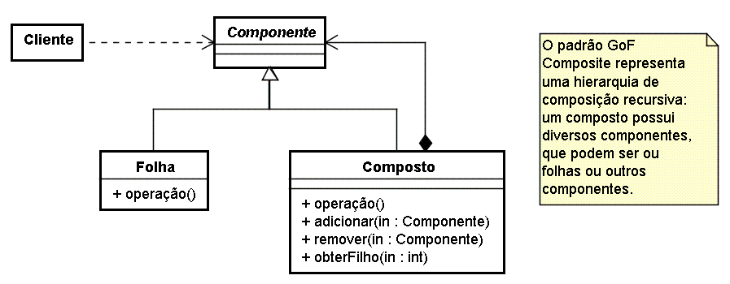
Padrão: Composite (Estrutural)
Modelagem de Software Orientado a Objetos
Princípios de Modelagem UML
Notes:
The purpose of the deployment diagram is to capture the configuration of processing elements, and the connections between processing elements in the system.
The deployment diagram consists of one or more:
Nodes (processing elements with at least one processor and memory)
Connectors between nodes and/or devices
The deployment diagram also maps processes on to these processing elements, allowing the distribution of behavior across nodes to be represented.
Introduce deployment diagrams to the students. Remember, this is new to them.

Slide 31
Onde Estamos?
Modelagem de Software Orientado a Objetos
Princípios de Modelagem UML
Categorias de Padrões de Projeto
Padrão: Composite
Padrão: Observer
Padrão: Strategy
Padrão: Factory Method
Padrão: Mediator
Padrão: Façade
Notes:
The goal for this section is to introduce, not teach everything about state machines.

Slide 32
Padrão: Observer (Comportamental)
Modelagem de Software Orientado a Objetos
Princípios de Modelagem UML
Possui o objetivo de definir de forma flexível uma dependência um para muitos entre objetos. Esta dependência é no sentido de que, se houver alguma modificação no estado do objeto central, os objetos dependentes devem ser notificados. A preocupação aqui é com o acoplamento: necessitamos que o objeto central seja capaz de enviar mensagens de notificação sem, no entanto, conhecê-los diretamente.
Notes:
The purpose of the deployment diagram is to capture the configuration of processing elements, and the connections between processing elements in the system.
The deployment diagram consists of one or more:
Nodes (processing elements with at least one processor and memory)
Connectors between nodes and/or devices
The deployment diagram also maps processes on to these processing elements, allowing the distribution of behavior across nodes to be represented.
Introduce deployment diagrams to the students. Remember, this is new to them.

Slide 33
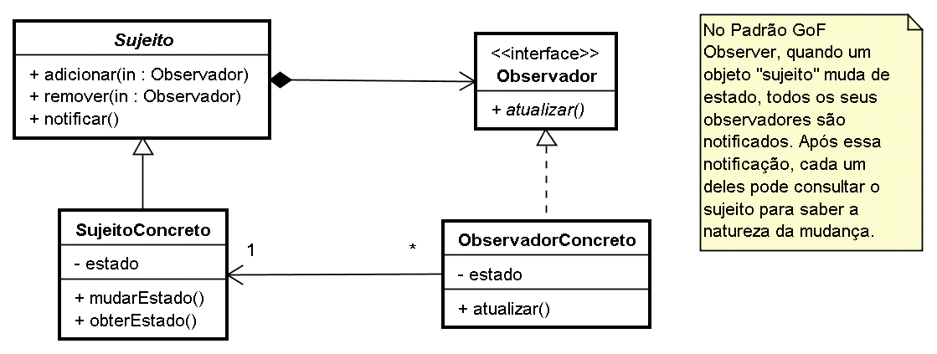
Padrão: Observer (Comportamental)
Modelagem de Software Orientado a Objetos
Princípios de Modelagem UML
Notes:
The purpose of the deployment diagram is to capture the configuration of processing elements, and the connections between processing elements in the system.
The deployment diagram consists of one or more:
Nodes (processing elements with at least one processor and memory)
Connectors between nodes and/or devices
The deployment diagram also maps processes on to these processing elements, allowing the distribution of behavior across nodes to be represented.
Introduce deployment diagrams to the students. Remember, this is new to them.

Slide 34
Onde Estamos?
Modelagem de Software Orientado a Objetos
Princípios de Modelagem UML
Categorias de Padrões de Projeto
Padrão: Composite
Padrão: Observer
Padrão: Strategy
Padrão: Factory Method
Padrão: Mediator
Padrão: Façade
Notes:
The goal for this section is to introduce, not teach everything about state machines.

Slide 35
Padrão: Strategy (Comportamental)
Modelagem de Software Orientado a Objetos
Princípios de Modelagem UML
Tem o objetivo de encapsular diferentes algoritmos para realização de alguma tarefa computacional por trás de uma interface e permitir que a região de código cliente dessa tarefa possa utilizar qualquer desses algoritmos sem precisar ser modificada.
Notes:
The purpose of the deployment diagram is to capture the configuration of processing elements, and the connections between processing elements in the system.
The deployment diagram consists of one or more:
Nodes (processing elements with at least one processor and memory)
Connectors between nodes and/or devices
The deployment diagram also maps processes on to these processing elements, allowing the distribution of behavior across nodes to be represented.
Introduce deployment diagrams to the students. Remember, this is new to them.

Slide 36
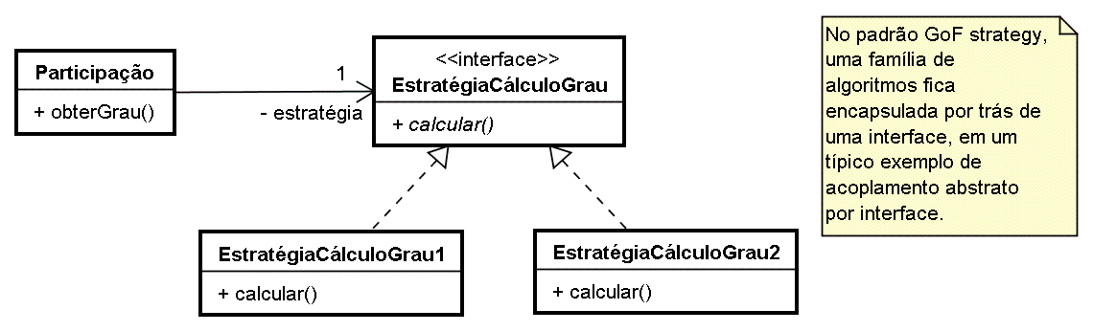
Padrão: Strategy (Comportamental)
Modelagem de Software Orientado a Objetos
Princípios de Modelagem UML
Notes:
The purpose of the deployment diagram is to capture the configuration of processing elements, and the connections between processing elements in the system.
The deployment diagram consists of one or more:
Nodes (processing elements with at least one processor and memory)
Connectors between nodes and/or devices
The deployment diagram also maps processes on to these processing elements, allowing the distribution of behavior across nodes to be represented.
Introduce deployment diagrams to the students. Remember, this is new to them.

Slide 37
Onde Estamos?
Modelagem de Software Orientado a Objetos
Princípios de Modelagem UML
Categorias de Padrões de Projeto
Padrão: Composite
Padrão: Observer
Padrão: Strategy
Padrão: Factory Method
Padrão: Mediator
Padrão: Façade
Notes:
The goal for this section is to introduce, not teach everything about state machines.

Slide 38
Padrão: Factory Method
Modelagem de Software Orientado a Objetos
Princípios de Modelagem UML
Possui o objetivo de criar uma forma de instanciar objetos sem que a região do código que realiza a instanciação do objeto fique acoplada à classe e sua forma específica de prover o serviço requerido. Este serviço de instanciação, por vezes, pode ser muito complexo.
Notes:
The purpose of the deployment diagram is to capture the configuration of processing elements, and the connections between processing elements in the system.
The deployment diagram consists of one or more:
Nodes (processing elements with at least one processor and memory)
Connectors between nodes and/or devices
The deployment diagram also maps processes on to these processing elements, allowing the distribution of behavior across nodes to be represented.
Introduce deployment diagrams to the students. Remember, this is new to them.

Slide 39
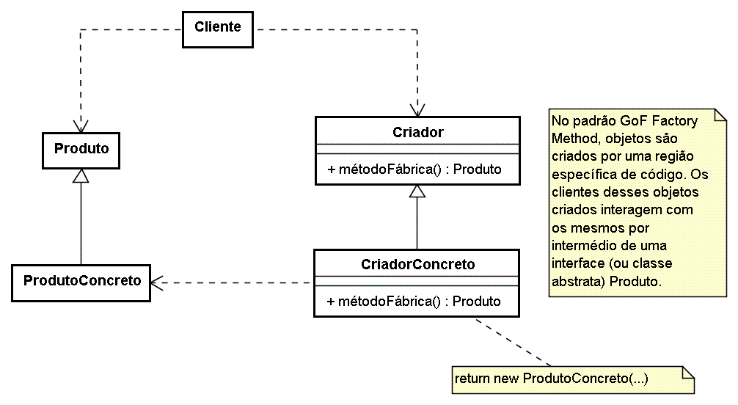
Padrão: Factory Method
Modelagem de Software Orientado a Objetos
Princípios de Modelagem UML
Notes:
The purpose of the deployment diagram is to capture the configuration of processing elements, and the connections between processing elements in the system.
The deployment diagram consists of one or more:
Nodes (processing elements with at least one processor and memory)
Connectors between nodes and/or devices
The deployment diagram also maps processes on to these processing elements, allowing the distribution of behavior across nodes to be represented.
Introduce deployment diagrams to the students. Remember, this is new to them.

Slide 40
Onde Estamos?
Modelagem de Software Orientado a Objetos
Princípios de Modelagem UML
Categorias de Padrões de Projeto
Padrão: Composite
Padrão: Observer
Padrão: Strategy
Padrão: Factory Method
Padrão: Mediator
Padrão: Façade
Notes:
The goal for this section is to introduce, not teach everything about state machines.

Slide 41
Padrão: Mediator
Modelagem de Software Orientado a Objetos
Princípios de Modelagem UML
Permite um grupo de objetos interagir com outro grupo de objetos ao mesmo tempo que mantém um acoplamento fraco. A solução é a criação de um objeto mediador para encapsular interações transferindo as requisições de um grupo para o outro. (exemplo: objetos Controller do MVC)
Notes:
The purpose of the deployment diagram is to capture the configuration of processing elements, and the connections between processing elements in the system.
The deployment diagram consists of one or more:
Nodes (processing elements with at least one processor and memory)
Connectors between nodes and/or devices
The deployment diagram also maps processes on to these processing elements, allowing the distribution of behavior across nodes to be represented.
Introduce deployment diagrams to the students. Remember, this is new to them.

Slide 42
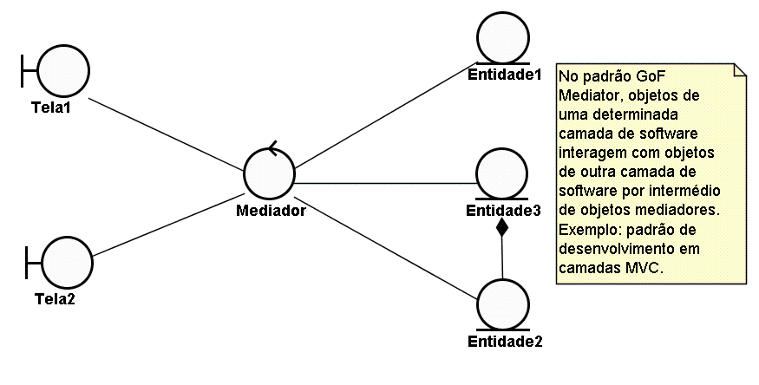
Padrão: Mediator
Modelagem de Software Orientado a Objetos
Princípios de Modelagem UML
Notes:
The purpose of the deployment diagram is to capture the configuration of processing elements, and the connections between processing elements in the system.
The deployment diagram consists of one or more:
Nodes (processing elements with at least one processor and memory)
Connectors between nodes and/or devices
The deployment diagram also maps processes on to these processing elements, allowing the distribution of behavior across nodes to be represented.
Introduce deployment diagrams to the students. Remember, this is new to them.

Slide 43
Onde Estamos?
Modelagem de Software Orientado a Objetos
Princípios de Modelagem UML
Categorias de Padrões de Projeto
Padrão: Composite
Padrão: Observer
Padrão: Strategy
Padrão: Factory Method
Padrão: Mediator
Padrão: Façade
Notes:
The goal for this section is to introduce, not teach everything about state machines.

Slide 44
Padrão: Façade
Modelagem de Software Orientado a Objetos
Princípios de Modelagem UML
Permite a definição de interfaces de comunicação entre subsistemas deixando-os fracamente acoplados. Define-se um uma interface de alto nível que torna o subsistema mais fácil de ser utilizado de tal forma que um cliente só se comunique com este subsistema através desta interface.
Notes:
The purpose of the deployment diagram is to capture the configuration of processing elements, and the connections between processing elements in the system.
The deployment diagram consists of one or more:
Nodes (processing elements with at least one processor and memory)
Connectors between nodes and/or devices
The deployment diagram also maps processes on to these processing elements, allowing the distribution of behavior across nodes to be represented.
Introduce deployment diagrams to the students. Remember, this is new to them.

Slide 45
Padrão: Façade
Modelagem de Software Orientado a Objetos
Princípios de Modelagem UML
X
Z
X
Z
Y
Y
<<interface>>
Façade
Notes:
The purpose of the deployment diagram is to capture the configuration of processing elements, and the connections between processing elements in the system.
The deployment diagram consists of one or more:
Nodes (processing elements with at least one processor and memory)
Connectors between nodes and/or devices
The deployment diagram also maps processes on to these processing elements, allowing the distribution of behavior across nodes to be represented.
Introduce deployment diagrams to the students. Remember, this is new to them.

Slide 46
Modelagem de Software Orientado a Objetos
Princípios de Modelagem UML
Dúvidas?

